Slide 1

Team Name : Workforce
Team Leader Name : Irfan Ahmed
Problem Statement : AI Analyst for Startup Evaluation :
Early-stage VC diligence is slow, inconsistent, and relies heavily on manual review of founder materials and scattered public data

Slide 2

Brief about the prototype:
AI-powered analyst that ingests founder materials (pitch deck, one-pager, bios), enriches with public data, and uses Google Cloud Vertex AI (Document AI, Embeddings, Vector Search, Generative Models) to produce a concise, actionable 1-page investment memo with a 0-100 attractiveness score and 3 due-diligence action items.

Slide 3
Opportunity should be able to explain the following:
How different is it from any of the other existing solutions?
How will it be able to solve the problem?
USP of the proposed solution
- Different from other solutions: Competing tools are generic deal-screening bots. Our solution uniquely integrates Google Cloud Document AI for structured extraction of KPIs from decks, Vertex Embeddings + Vector Search for evidence-grounded retrieval, and Vertex Generative for concise memo synthesis. - Solves the problem: Automates 80% of the manual screening effort, ensures consistent, data-backed analysis, and surfaces red flags early, helping investors focus only on the most promising startups. - USP: End-to-end on Google Cloud with explainability — every insight is tied back to a cited slide/chunk. Fast (under 1 min per deck), scalable, and produces investment-grade memos with due-diligence checklists.

Slide 4
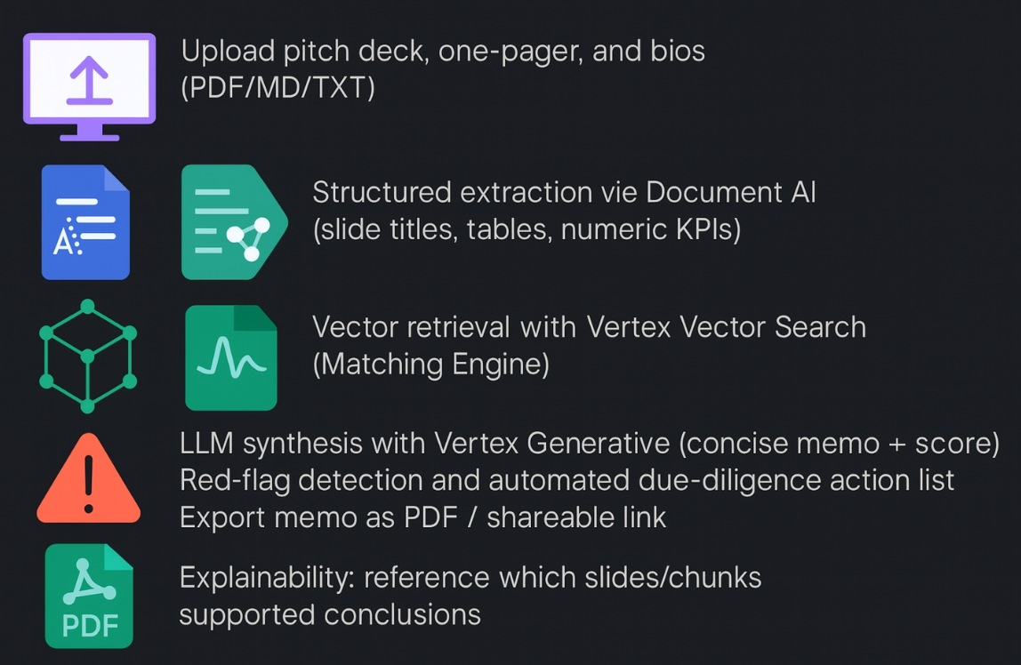
List of features offered by the solution

Slide 5
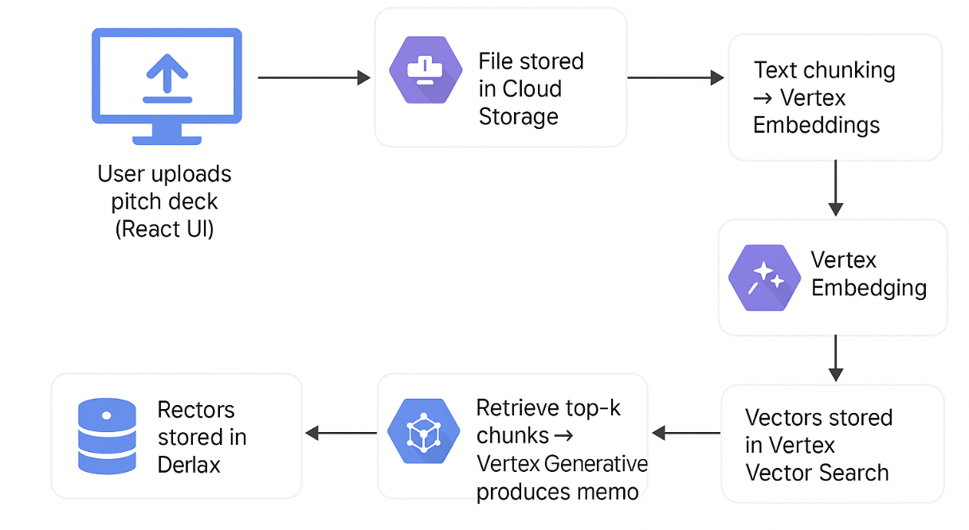
Process flow diagram or Use-case diagram

Slide 6
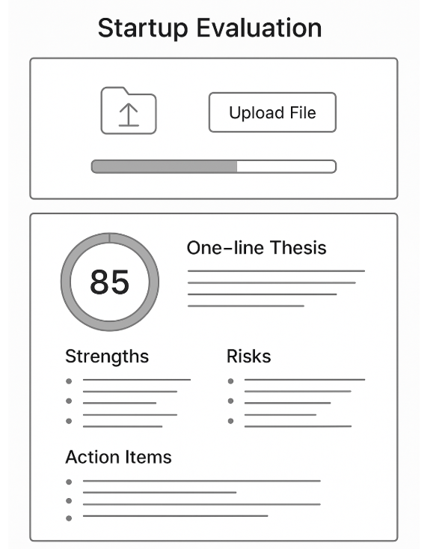
Wireframes/Mock diagrams of the proposed solution (optional)
Simple single-page app with upload panel, progress indicator, results card showing:
0-100 score One-line thesis 3 strengths, 3 risks 3 action items

Slide 7
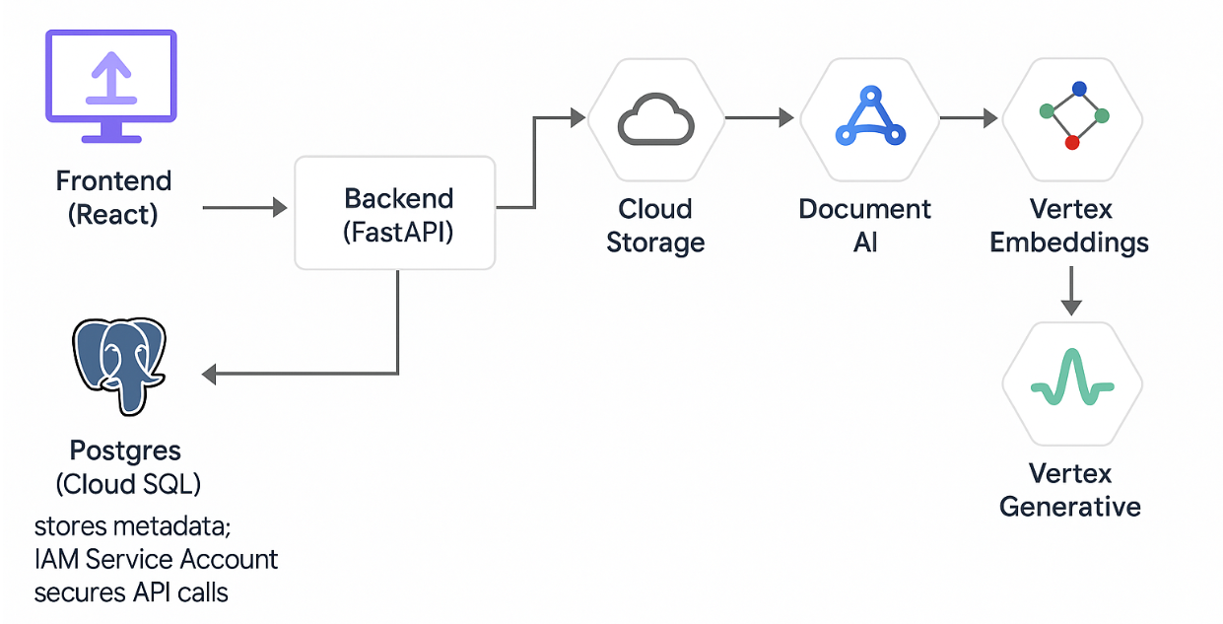
Architecture diagram of the proposed solution

Slide 8
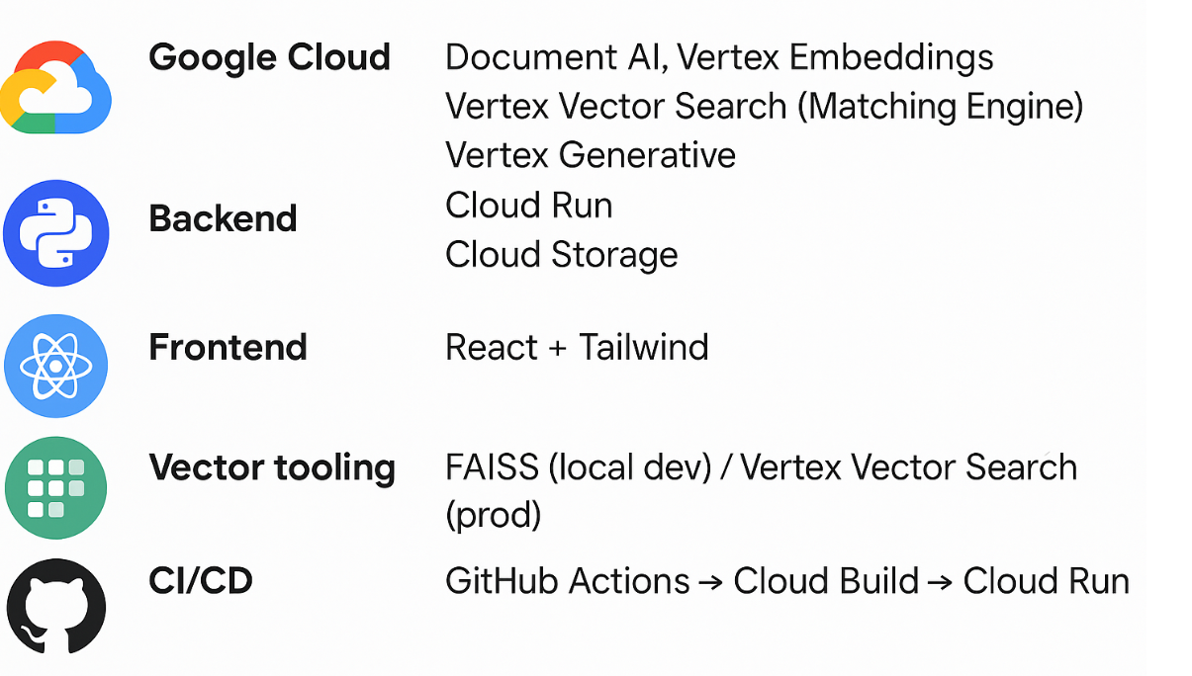
Technologies to be used in the solution:

Slide 9
Estimated implementation cost (optional):

Slide 10
Add as per the requirements for the hackathon:

Slide 11


